Slide 1

HSTS Bypass with Bettercap
By Junyi Zou, Jinliang Zhang
Electrical and Computer Engineering
Introducing to Hacking

Slide 2


Slide 3

What Is Bettercap?
Bettercap is the Swiss army knife for network attacks and monitoring.
Bettercap is a complete, modular, portable and easily extensible MITM tool to perform a man in the middle attack.

Slide 4
Some of the major features are as follows:
DNS spoofing.
Web sniffer.
Modular HTTP and HTTPS proxy.
Use HSTS bypass technology to unseal SSL.

Slide 5
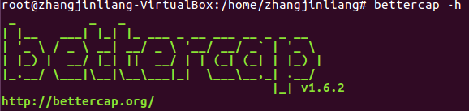
As with most tools, there are quite a few different switches available.
Main:
-T: specify MITM targets (IP or MAC)
-I: interface to use
-G: specify gateway address (usually automatic)
Sniffing:
-X: enable sniffer mode
-L: sniffer from your host as well
Spoofing:
-S: spoof using ARP, ICMP, NONE
--kill: kills connections from any current targets

Slide 6
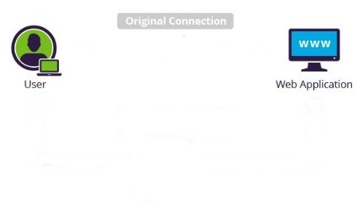




Man-in-the-middle Attack
x
Hack incentives:
Eavesdrop valuable messages
Alter message contents
Insert Java Script to HTML (cryptojacking malware such as coinhive)

Slide 7
Now, https is the mainstream mode of web connection, from which information is more valuable.
How to hack https communication?

Slide 8
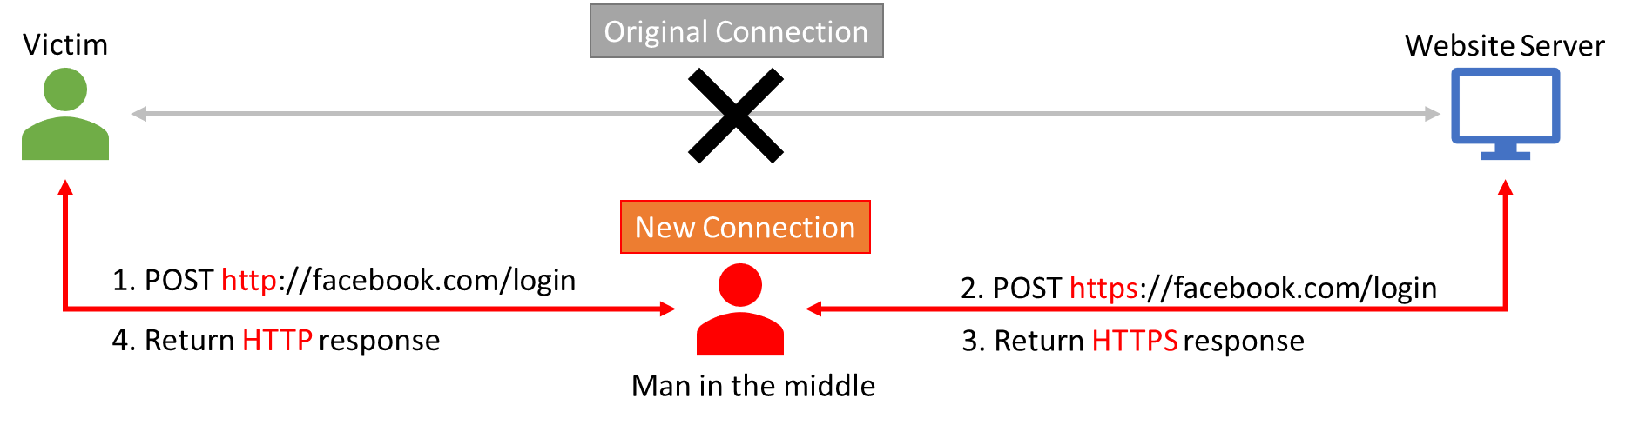
Before November 2012, SSL stripping was accomplished easily.
x
HTTP is used between victim and attacker,
HTTPS is used between attacker and web server.
Attacker secretly relays and alters HTTP and HTTPS communications.

Slide 9
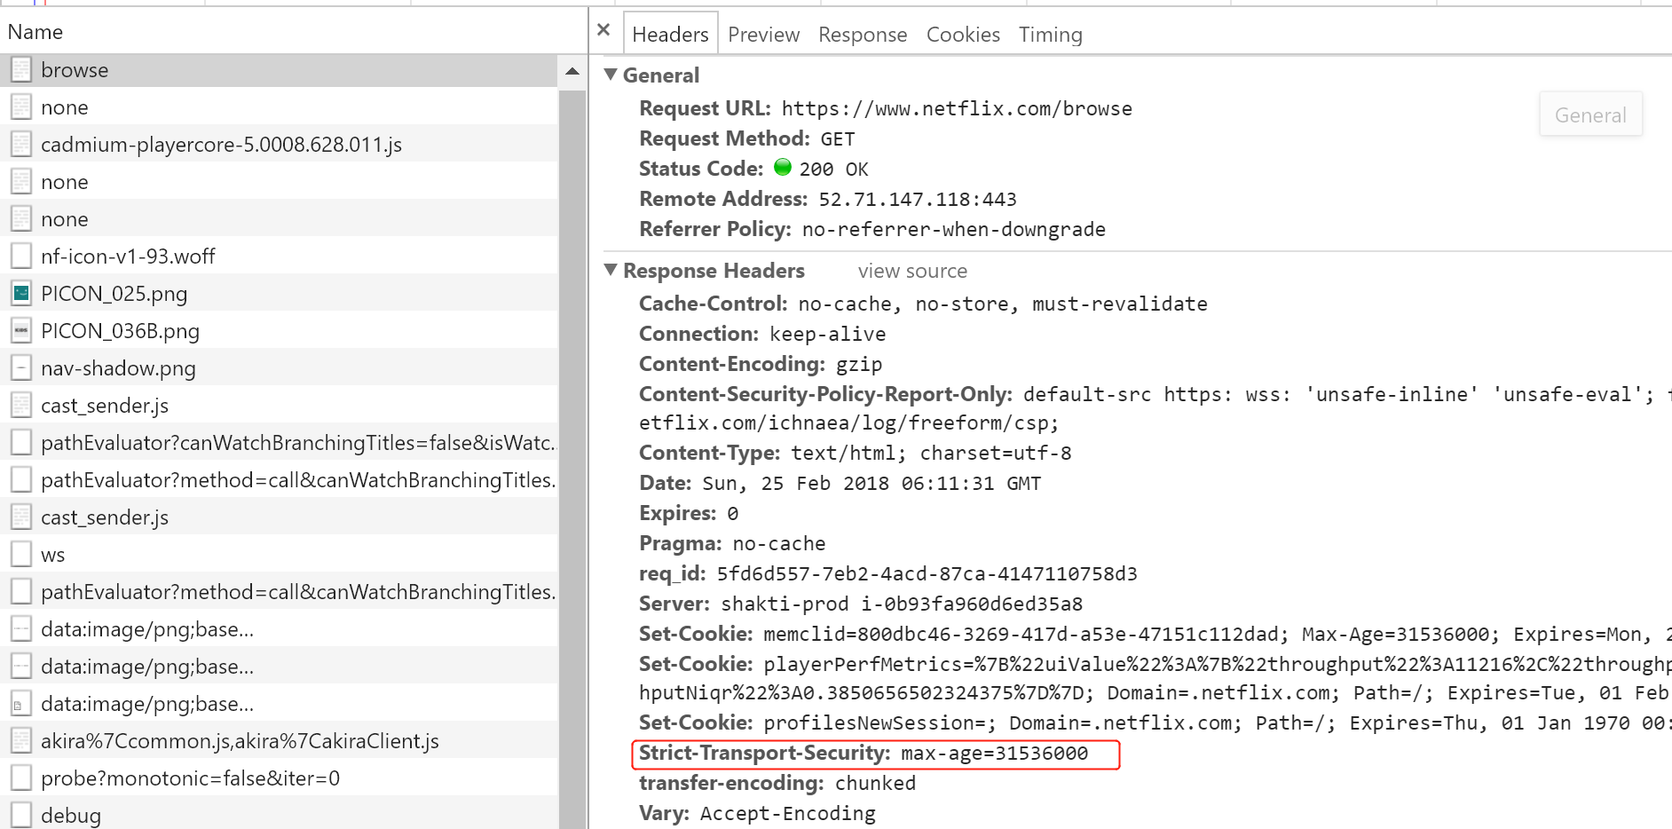
In November 2012, HTTP Strict Transport Security (HSTS) is proposed (rfc6797)
HSTS is a mechanism by which a server can indicate that the browser must use HTTPS when communicating with it.
1. Facebook -> user
Strict-Transport-Security: max-age=3600
It tells browser that Facebook support HTTPS.
2. User ->Facebook
Facebook told me it supports HTTPS, So I use HTTPS.
3. Attacker
Attacker can’t decrypt HTTPS, Communication is secure.
P.S.
Chrome has supported HSTS since September, 2009.
Firefox has supported HSTS since March 22, 2011.

Slide 10
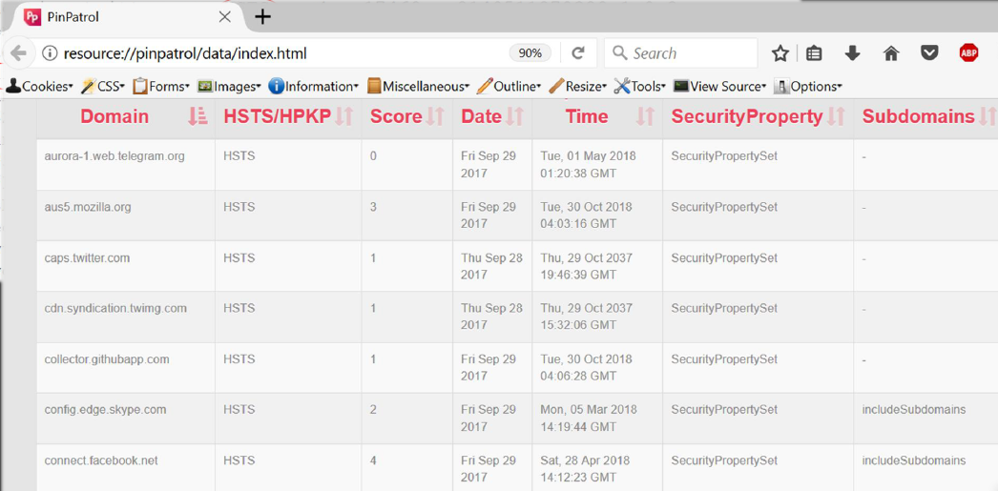
HSTS Mechanism:
Browser maintains a table.
HSTS Table records : what https website has visited, how many time client has visited.
Firefox: maximum 1024 records
Chrome: no storage limit

Slide 11
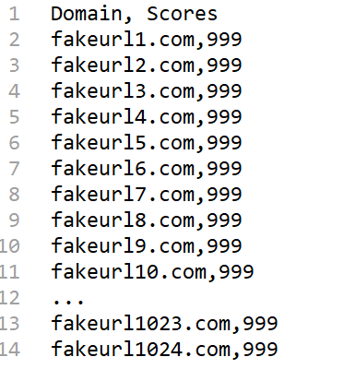
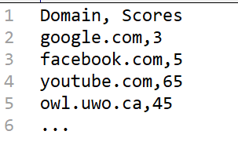
HSTS Bypass
Because Firefox can only have maximum 1024 records, the attacker can flood the HSTS table with junk information.
Use JS injection to inject junk https entries, so real entries is overwritten.
After Flood
Original HSTS Table
Flooded HSTS Table

Slide 12
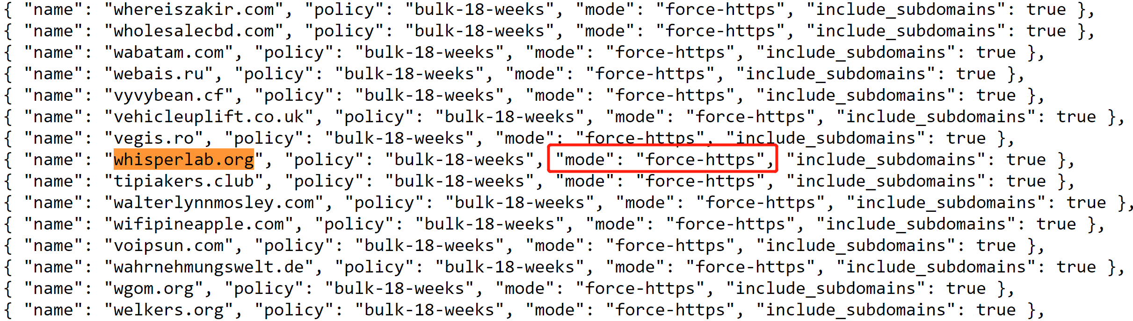
Solution:
HSTS pre-loaded List of HSTS sites.
IE has supported HSTS pre-loaded List since February 16, 2015.
Limitations:
Some websites not in the list (such as OWL).
Can’t include all the HTTPS websites in the world.

Slide 13
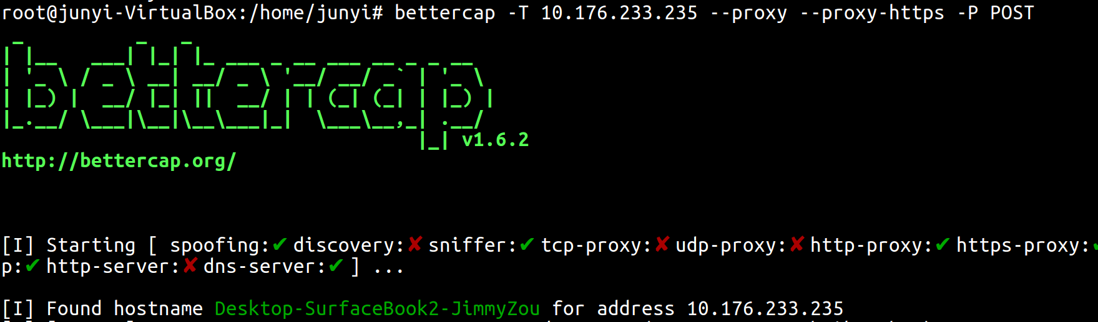
How to hack UWO Account
Step 1:

Slide 14
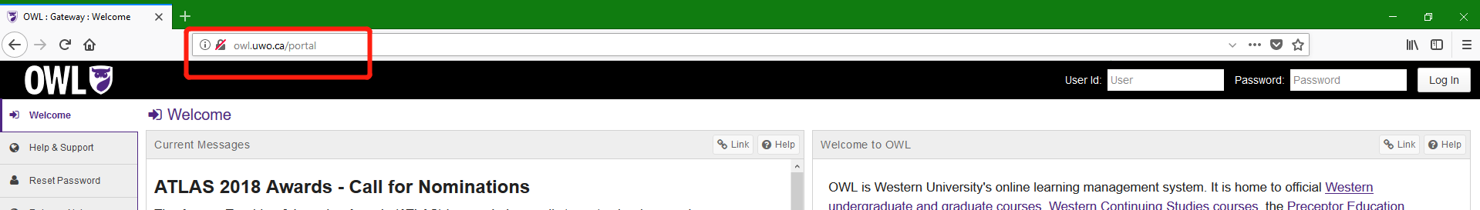
Step 2:

Slide 15
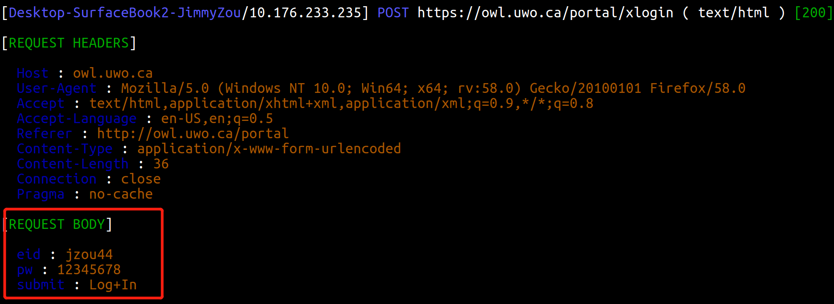
Step 3:

Slide 16
Conclusion
To avoid bypassing HSTS by SSL Strip attack:
Submit your https website to https://hstspreload.org/.
Never trust http website as http is insecure.
Update browser to newest version.
Use Chrome.

Slide 17
Thank you

